Slide 1
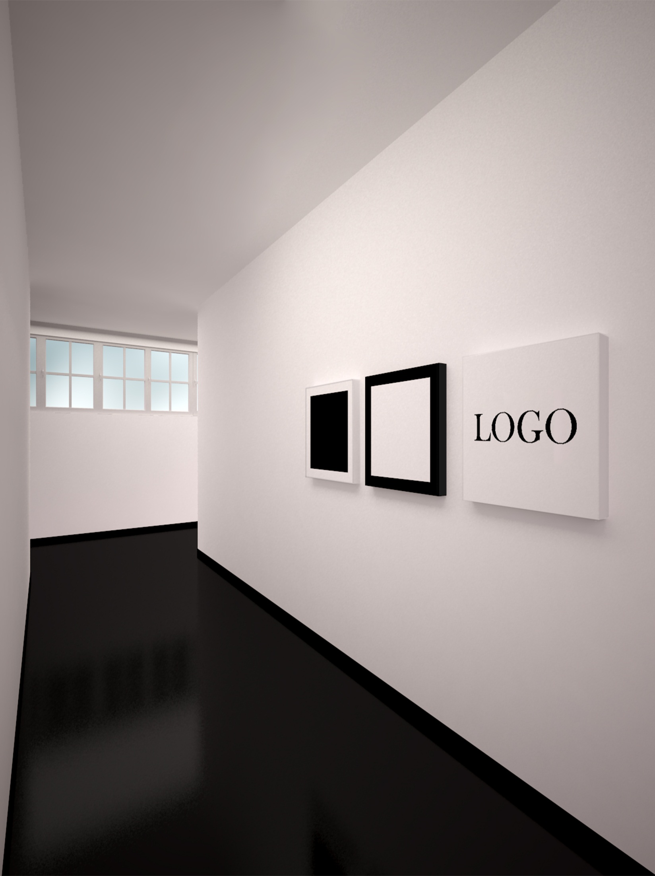
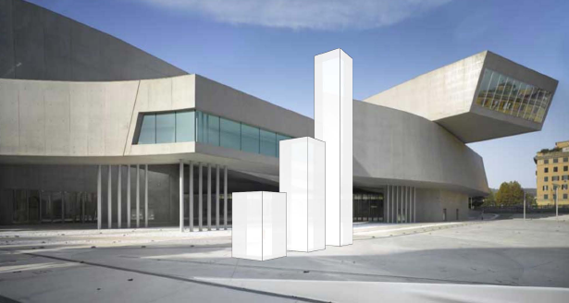
pptArt®
pptArt® is the one-stop shop for art-related corporate services.
Contrary to common and established perception, pptArt® maintains that the corporate world can be the object of art.
The pptArt® manifesto has been signed by over 1,000 artists globally, mainly from the United States (25%) and the UK (15%).
www.pptArt.net
pptArt®
THE CULTURAL INITIATIVE
“Good business is the best art”
Andy Warhol
pptArt® is a contemporary art movement founded by a group of international MBAs in collaboration with Italian artists. It aims at rectifying a distorted and simplistic perception of the complexity of the Corporate World in order to promote the positive role of business in today’s society.
The pptArt® name comes from PowerPoint, the symbolic and abstract language developed by the corporate world which has become a universal and highly symbolic communication system beyond cultures and borders.
Since 2013 the concept and aesthetics of pptArt® have become a formal course at the post-graduate Master of Art at Luiss Business School in Rome.
In the first half of 2015, one of the major contemporary art museums in Rome will organize the first pptArt® exhibition. Over twenty Italian blue-chip companies have already confirmed their interest in exhibiting their collaborations with the world of art.
ppt
Art

Slide 2

pptArt®
pptArt® is the one-stop shop for art-related corporate services.
Contrary to common and established perception, pptArt® maintains that the corporate world can be the object of art.
The pptArt® manifesto has been signed by over 1,000 artists globally, mainly from the United States (25%) and the UK (15%).
www.pptArt.net
pptArt®
MANIFESTO
The traditional relationship between the Corporate world and the arts is a one-way affair limited to patronage. Though organizations may endorse, sponsor or fund artists and museums, the arts seem to have nothing to offer from a business perspective.
By refusing the dialogue with the complexity of the corporate dynamics, the arts have deprived themselves of an interesting field of exploration.
Contrary to common and established perception, pptArt® maintains that the Corporate World can be the object of art. A corporation represents an active agent which contributes to the progress of society. Business influences habits and tastes, promotes research, establishes bridges and professional relations across cultures. Its complexity can be a source of beauty.
Distribution
Global distribution of pptArt manifesto signatories.
Total: >1,000
ppt
= 25%
Art

Slide 3
pptArt®
pptArt® is the one-stop shop for art-related corporate services.
Contrary to common and established perception, pptArt® maintains that the corporate world can be the object of art.
The pptArt® manifesto has been signed by over 1,000 artists globally, mainly from the United States (25%) and the UK (15%).
www.pptArt.net
pptArt®
MANIFESTO ARTWORK
pptArt® aesthetics, historical references and main messages are summarized in its manifesto artwork “One and three logos”, a threefold representation of a company logo. The key message is that the corporate world, in its formal and conceptual representation, can be the object of a work of art.
Despite the apparent simplicity and minimalism of the triptych, this work is a powerful précis of the pptArt® message. At the same time, it pays tribute to its historical precursors in suprematism and conceptual art: the tryptical structure is a reference to Kosuth’s “One and three chairs” while the central element is a reference to Malevich’s “Black square on white ground”.
The word “logos” in the title is also to be interpreted in the ancient Greek meaning as a principle of order and knowledge. This refers to the intrinsic nature of the corporate world as the product of the rational mind to reestablish an order in the chaos of the markets and the human needs.
ppt
Art

Slide 4
pptArt®
pptArt® is the one-stop shop for art-related corporate services.
Contrary to common and established perception, pptArt® maintains that the corporate world can be the object of art.
The pptArt® manifesto has been signed by over 1,000 artists globally, mainly from the United States (25%) and the UK (15%).
www.pptArt.net
pptArt®
CORPORATE SERVICES
WHEN PACKAGING BECOMES ART
Packaging has long been more than a simple container or wrapper for a product.
With pptArt® you can now enrich your packaging through a contest of artists. Based on your guidelines and specifications, our pool of over 1,000 qualified international artists is ready to interpret your packaging design evolution with the diversity of their styles and concepts. Their artistic proposals can become an active tool to engage your clients in the selection of the best design through a social media campaign.
ENHANCE YOUR MARKETING CAMPAIGNS
Have you ever thought that art can enhance your marketing campaigns?
Here is a list of pptArt® suggestions:
Social media campaigns: engage your customers and drive traffic to your website! Ask them to take a selfie while using your products with their friends or partner. The best photo will become a work of art
Loyalty programs: our glass and metal artists can create unique pieces for your loyalty programs
Printed advertising: tired of the usual graphic design, illustrators and photographers? Create artistic images through our pool of over 1,000 artists
ppt
Art

Slide 5
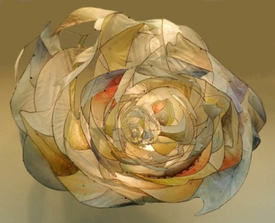
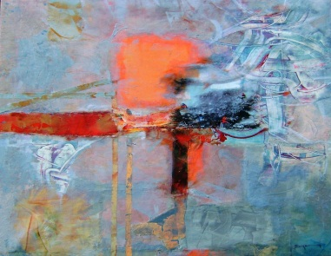
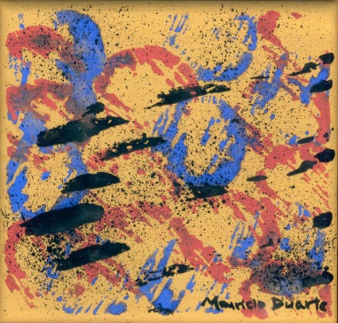

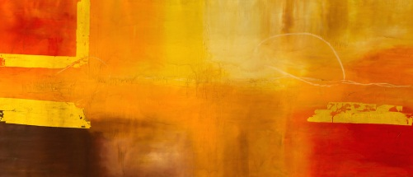
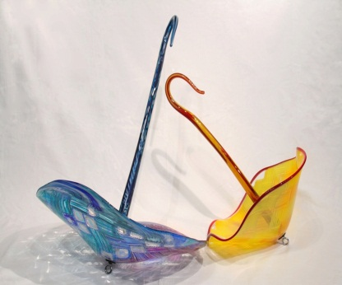
pptArt®
ARTISTS (Sample)
pptArt®
ARTISTS (Sample)
King, Jill
(USA)
Bergamini, Marilena
(Italy)
Duarte, M. Antonio
(Brazil)
Elansari, Mostafa
(Morocco)
Gnagnarella, Francesca
(Italy)
Morrison, Christopher
(USA)

Slide 6
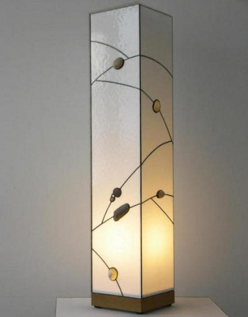
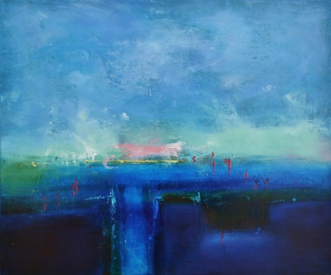
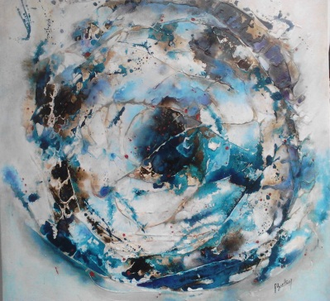
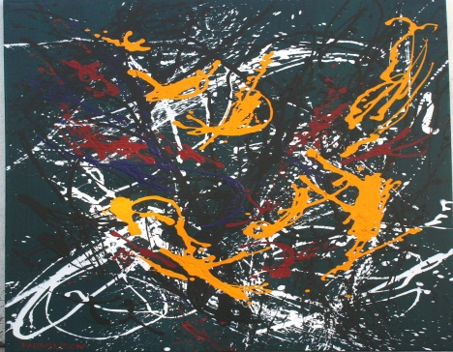

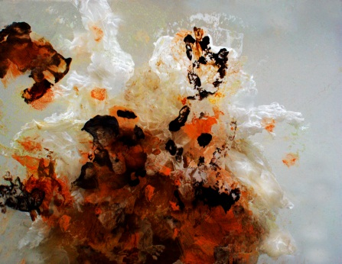
pptArt®
ARTISTS (Sample)
pptArt®
ARTISTS (Sample)
Inka, Gabriel
(Germany)
Andrews, Barry
(UK)
Boetner, Susana
(Argentine)
Phillips, Fred
(Barbados)
Starkey, Marius
(USA)
Forrest, J. Gary
(USA)

Slide 7
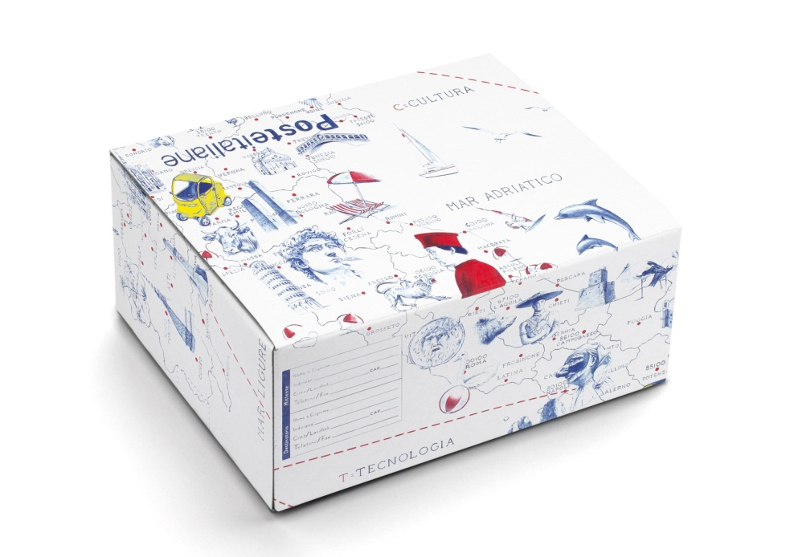
pptArt®
pptArt® is the one-stop shop for art-related corporate services.
Contrary to common and established perception, pptArt® maintains that the corporate world can be the object of art.
The pptArt® manifesto has been signed by over 1,000 artists globally, mainly from the United States (25%) and the UK (15%).
www.pptArt.net
pptArt®
REFERENCES
WHEN PACKAGING BECOMES ART
In collaboration with our Italian partner Giubilarte*, a new package has been designed for Poste Italiane (the leading Italian postal service operator) through a competition of artists. The design has been used for a limited-edition Christmas package.
The winner of the 2013 competition was the artist Giuseppe Stampone. He was voted by a popular jury through a social network campaign.
* Giubilarte is an Italian-based company specialized in the organization of art-related events and projects
ppt
Art

Slide 8
pptArt®
pptArt® is the one-stop shop for art-related corporate services.
Contrary to common and established perception, pptArt® maintains that the corporate world can be the object of art.
The pptArt® manifesto has been signed by over 1,000 artists globally, mainly from the United States (25%) and the UK (15%).
www.pptArt.net
pptArt®
PROCESS
Client
pptArt®
Artists
Definition of guidelines for packaging evolution
Preparation of brief as input for artists
Organization of contest through crowdsourcing platform
Elaboration of proposals
Ranking of proposals with art advisors
Choice of best proposal
Original artwork development
ppt
Art

